Slide 1
WP3 Data Quality
27th June 2022
Data Quality Assurance

Slide 2
Agenda
Intro/Welcome
WP Deliverables
WP Tasks
Recruitment Update
WP3 deliverable integration with architecture
Review of survey results
AOB

Slide 3
Welcome
UCD (WP Leader)
VC
ES
ICON
TM
TWM
Dell EMC
Establish the contribution that everyone can make
We need input from all to fully understand what quality means in different contexts

Slide 4
Deliverables & Milestones
D3.1 Design of Data Quality Adjudication Framework (M19)
Task 3.1 Quality will be assessed across numerous dimensions including completeness, adjacency (spatial & temporal), lossiness, noise but also other factors including suitability for ML use cases e.g. are the labels/annotations of suitable volume, quality, and class distributions.
Subsequent quality service bundles will address quality measures across the big data model stages;
pre-processing, conflation, analytics and usage.
D3.2 Design and Implementation of Data Quality Filter (M24)
MS3.1 Delivery of Data Quality Filter (M24)

Slide 5
Agenda
Intro/Welcome
WP Deliverables
WP Tasks
Recruitment Update
WP3 deliverable integration with architecture
Review of survey results
AOB

Slide 6
Agenda
Intro/Welcome
WP Deliverables
WP Tasks
Recruitment Update
WP3 deliverable integration with architecture
Review of survey results
AOB

Slide 7
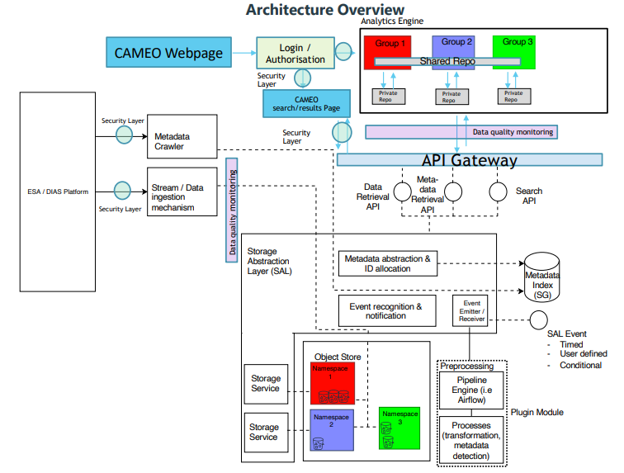
CAMEO
Architecture
Data Quality Monitoring (D1.1)
This component ensures that the data being ingested meets the quality required to satisfy the user queries. Some key data dimensions are: Completeness: Is data missing or not user friendly? Timeliness: Is data available for use in the time frame in which it is expected? Conformity: Is the data conforming to expected format? Uniqueness: Is the data duplicated within the available data set? Integrity: Ensure integrity of data and its relationships along with source or lineage of the data. Is the integrity ensured? Consistency: Is there a single source of truth or are different versions for the same data entity available across multiple environments? Accuracy: Is the data accurately representing the business data as expected?

Slide 8
Agenda
Intro/Welcome
WP Deliverables
WP Tasks
Recruitment Update
WP3 deliverable integration with architecture
Review of survey results
AOB

Slide 9
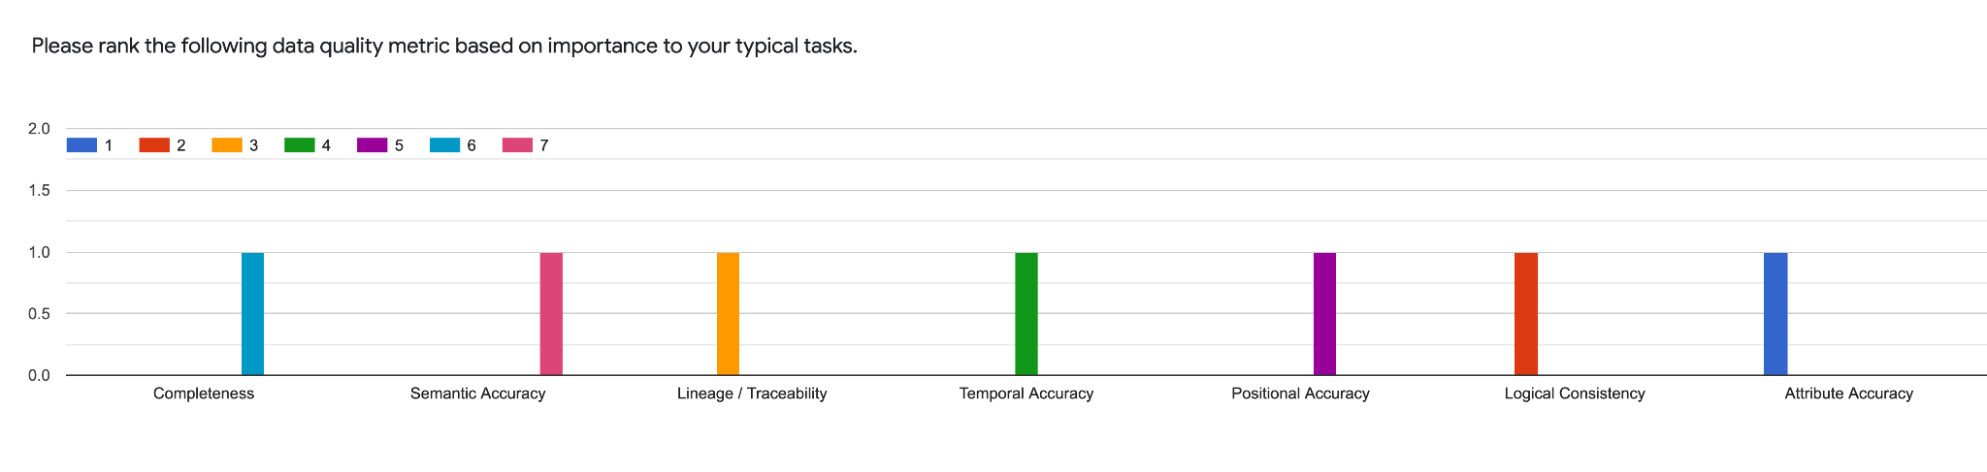
Survey Results

Slide 10
Current Practices
Data Validation Sources: Met Eireann, EPA, ESA, NASA, OpenWeatherMap, Windy.com, EUMETSAT
Validation:Validation work generally occurs as part of R&D / scientific projects. Imagery from providers such as ESA & NASA are generally considered accurate enough for operational purposes.
Ground Truthing: Platforms, data ingress software, and satellite processing chains are proprietary.
Outliers: For satellite images: land and clouds are masked from the images (not required for marine EO). For in-situ data: outliers are removed if they cannot be explained following investigation.
Cleaning: Noise can be mitigated in SAR images using speckle filters (Lee filters etc.). Noise in optical images can be mitigated using smoothing filters, destriping algorithms, and by masking.

Slide 11
Agenda
Intro/Welcome
WP Deliverables
WP Tasks
Recruitment Update
WP3 deliverable integration with architecture
Review of survey results
AOB

Slide 12
Questions, AOB, Discussion
Call for Action - Please complete Survey.

Slide 13
WP3 Data Quality?
ESA DataProduct Quality Reports
ISO 19115-1:2014 - minimum and mandatory metadata fields that should accompany spatial data
ISO 19157:2013 - describing components and 4 principles for the quality of spatial data
International Cartographic Association (ICA)
Lineage, Positional Accuracy, Attribute Accuracy, Completeness, Logical Consistency, Semantic Accuracy, Temporal Data.
OGC Data Quality
Sector specific ones (transport, environment, etc)
Establishment of Sector Specific Needs in Terms of Quality
What quality means to different sectors?
Examples of good quality data (ground truth)?

